Slide 1
Safety Guidelines

Slide 2
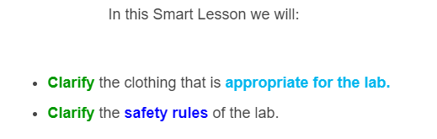


Slide 3

There are many hazards in the lab, but if you follow the guidelines in this lesson you should be able to stay in one piece!

Slide 4


A knight wouldn't ride into battle without their suit of armour, just like a scientist should never walk into the lab without their lab coat.
A lab coat will protect your skin and clothes from corrosive chemicals, which can cause serious burns!

Slide 5

Of course, you can't cover your face with a lab coat.
This is why you should always wear your safety glasses as well.
Safety glasses protect your eyes from splashed chemicals or irritating particles.

Slide 6

A lab coat won't protect your feet either, so it is important that you always wear closed footwear.
This means no sandals, thongs or bare feet!

Slide 7
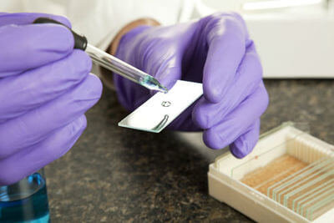

If you're ever handling particularly dangerous chemical, you will also want to wear gloves.
There are different types of gloves for different chemicals, but they're all there to protect your hands from spills or unseen residues.

Slide 8
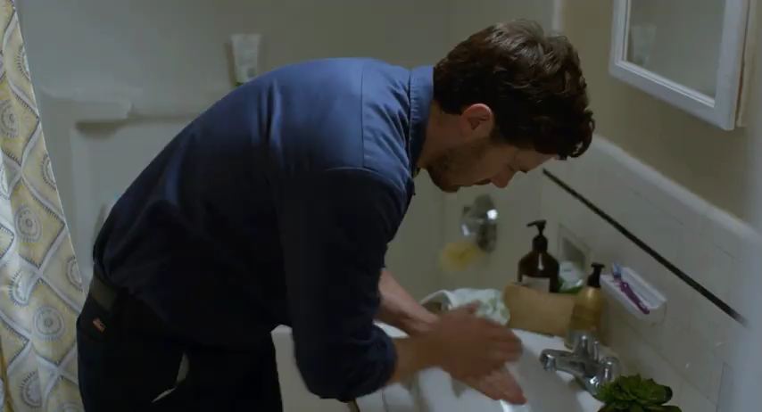
You should always wash your hands when you leave the lab.
This prevents you from accidentally taking any dangerous chemicals or other residues away with you!

Slide 9
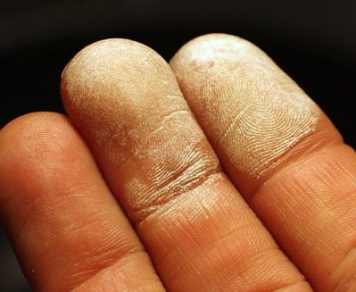
Do not take any food or drink into the lab.
Laboratories can contain toxic chemicals or biological material that you definitely don't want finding their way into your sandwich!

Slide 10

If you have long hair, it is important that you tie it back.
The last thing you want is to have your hair dangling in a beaker of acid or catching fire!

Slide 11
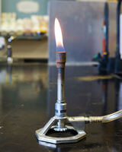

Many experiments in the lab will use unfamiliar equipment, such as Bunsen burners and electrical circuits.
It is important that you have read their instructions thoroughly and feel confident in their operation before you get started.

Slide 12
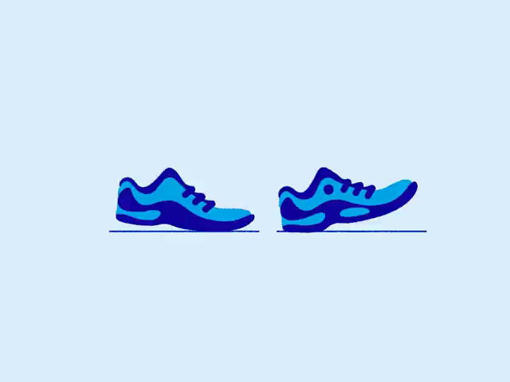
Do not run in the lab.
Labs are full of glassware, chemicals and electrical equipment. These things can be dangerous enough without you running amok!

Slide 13


If you do spill or break anything, you should tell your teacher immediately.
They will be more concerned with getting it cleaned up correctly than telling you off!

Slide 14

Always read the instructions, and ask your teacher if you are ever unsure what you should be doing.
Scientific experiments are all carefully organised to be as safe as possible, so long as you follow the directions!

